Slide 1
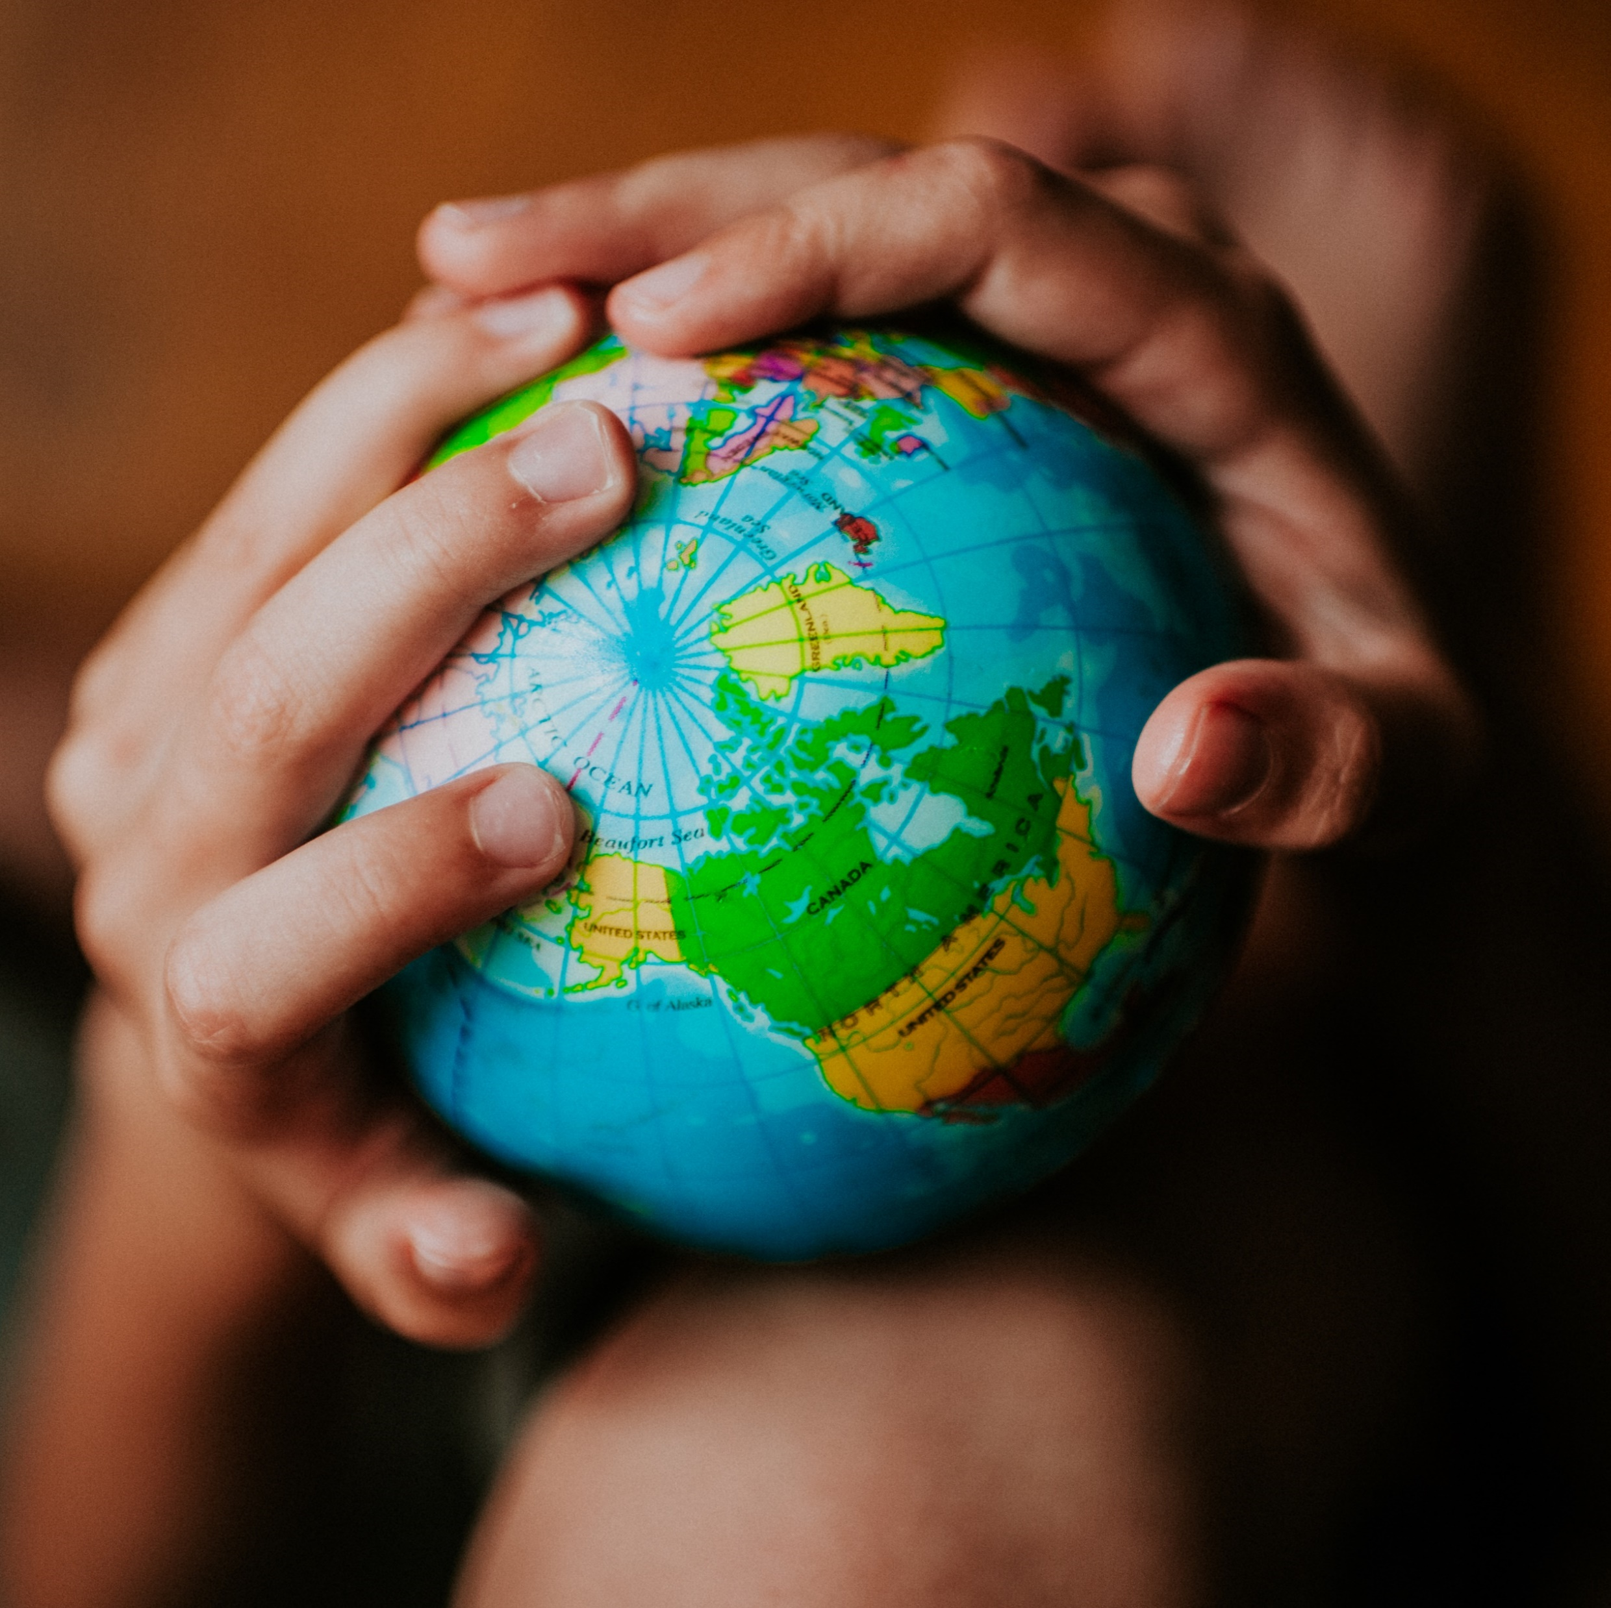
Welcome
Global health
Session 11
Dr. Tilly Paz

Slide 2

In this session you will:
Define culture
Describe the most important conceptual relationships between culture and health
Outline some of the theories of how behavior change occurs in health
Describe some key measures to promote behavior change for better health in a cultural context

Slide 3
The Concept of Culture
Culture: “behavior and beliefs that are learned and shared”
Culture influences family, social groups, individual growth, communication, religion, art, politics, and the economy
Health policies and programs must always keep culture in mind
Critical to note – some cultural practices enable good health but some do not

Slide 4
Health Beliefs and Practices
Perceptions of Illness and disease
Illness: “personal, interpersonal, and cultural reactions to disease or discomfort”
Vary across groups
One culture may view certain signs or symptoms as an affliction while others consider them normal
Disease: “malfunctioning or maladaptation of biologic and psychophysiologic processes in the individual”
Some cultures believe illness can be caused by emotional stress, supernatural causes, or bodily imbalance

Slide 5
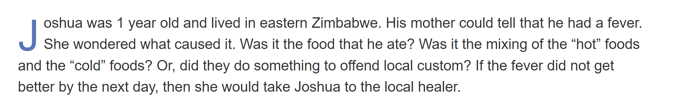
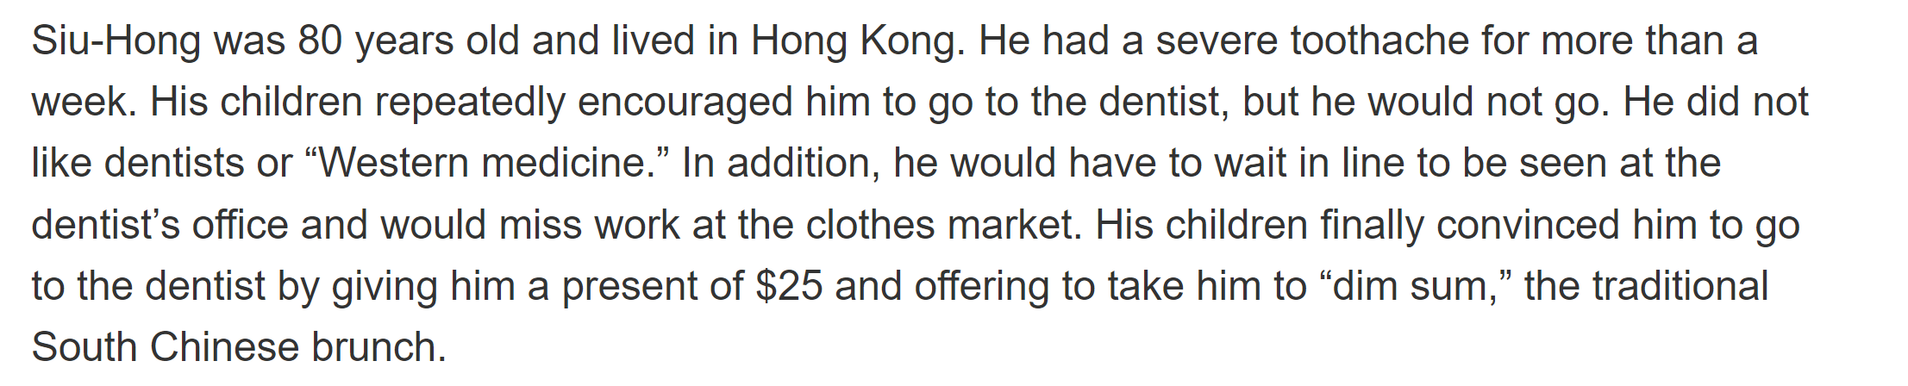

Slide 6
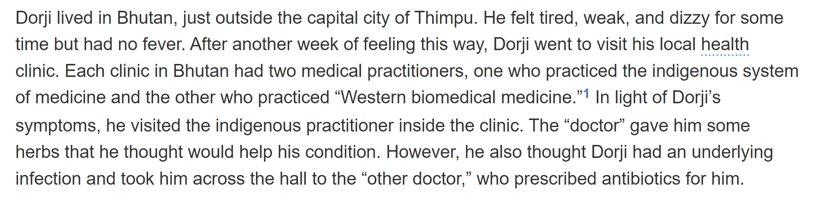

Slide 7
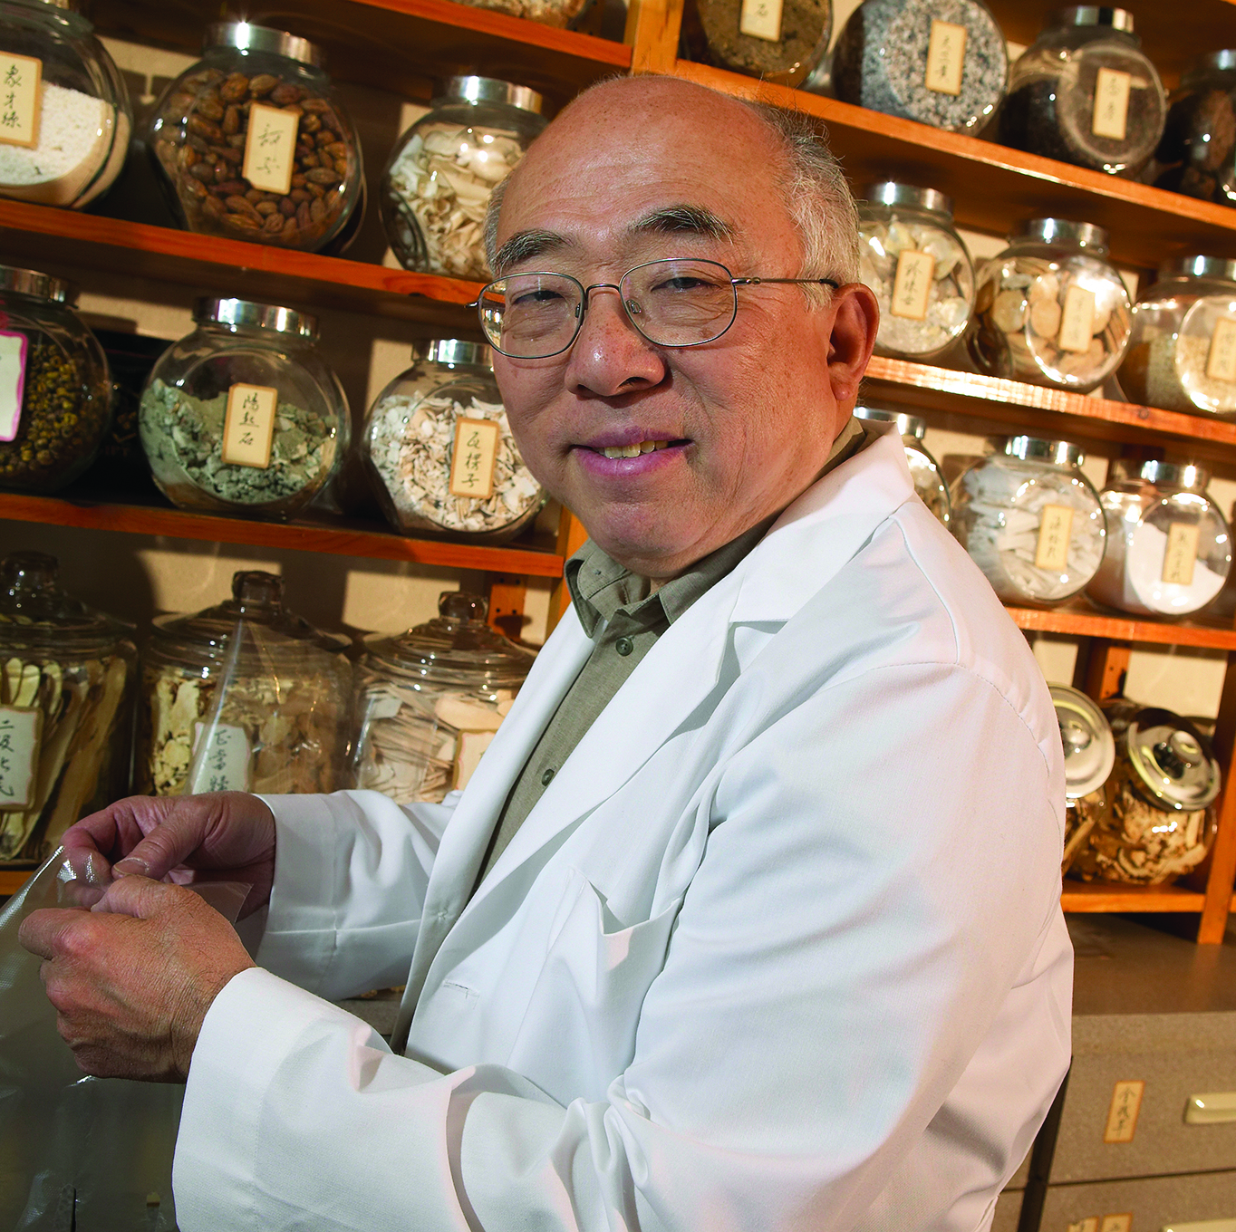
The Importance of Culture to Health
China has a well articulated system of “traditional medicine” reflected in this Chinese medicine shop.

Slide 8
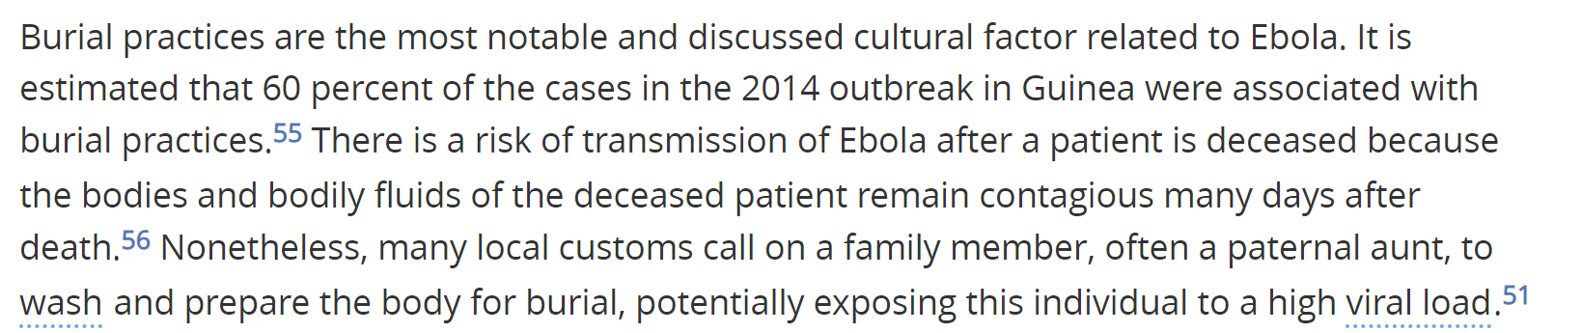
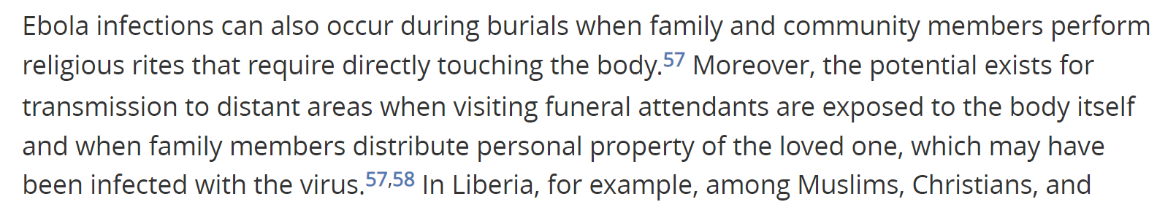
Burial practices and Ebola

Slide 9

Health Beliefs and Practices
The Diagnosis and Treatment of Illness and the Use of Health Services
Common to try a home remedy, then visit a local healer, then consult a “western doctor”
“Patterns of resort” affected by cost of services and manner in which the provider treats them socially
Notes:
What’s our home remedy? How do you treat getting ill?

Slide 10
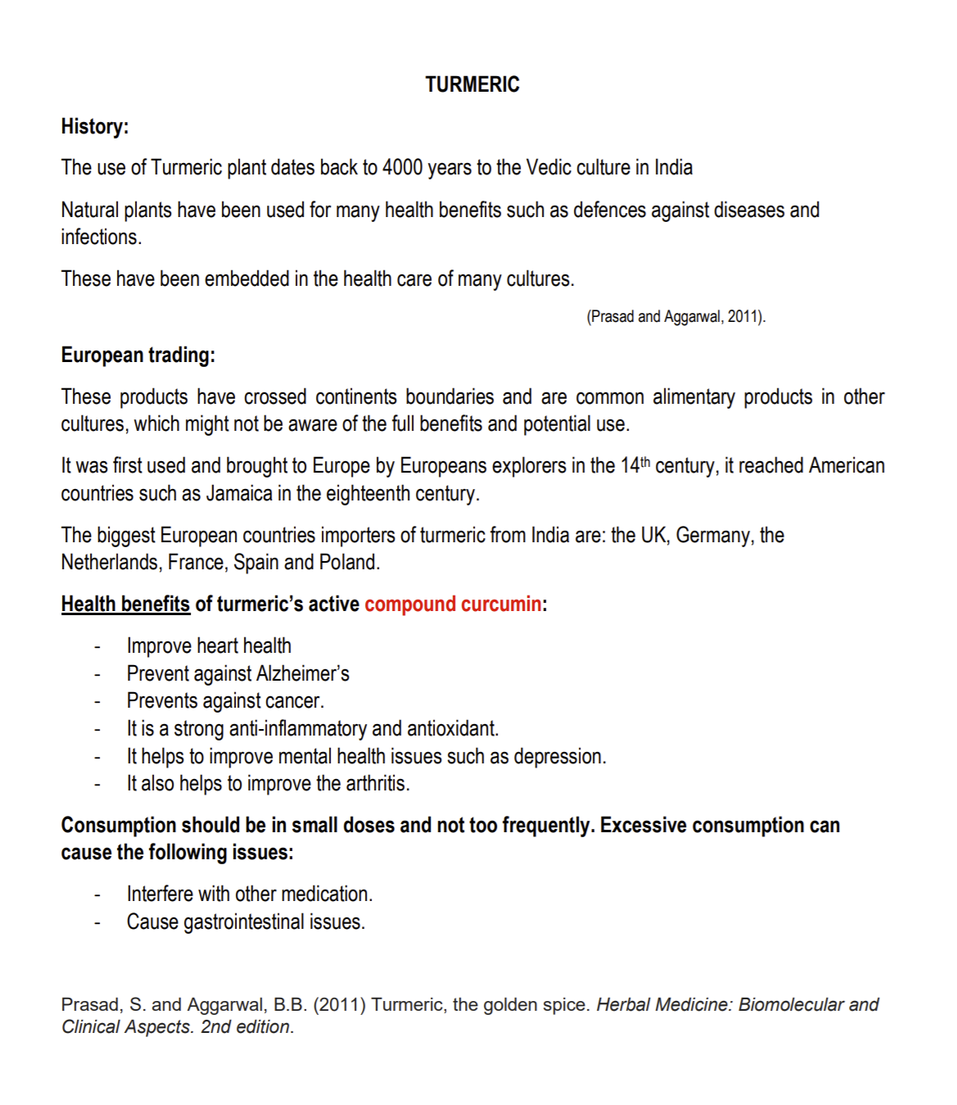
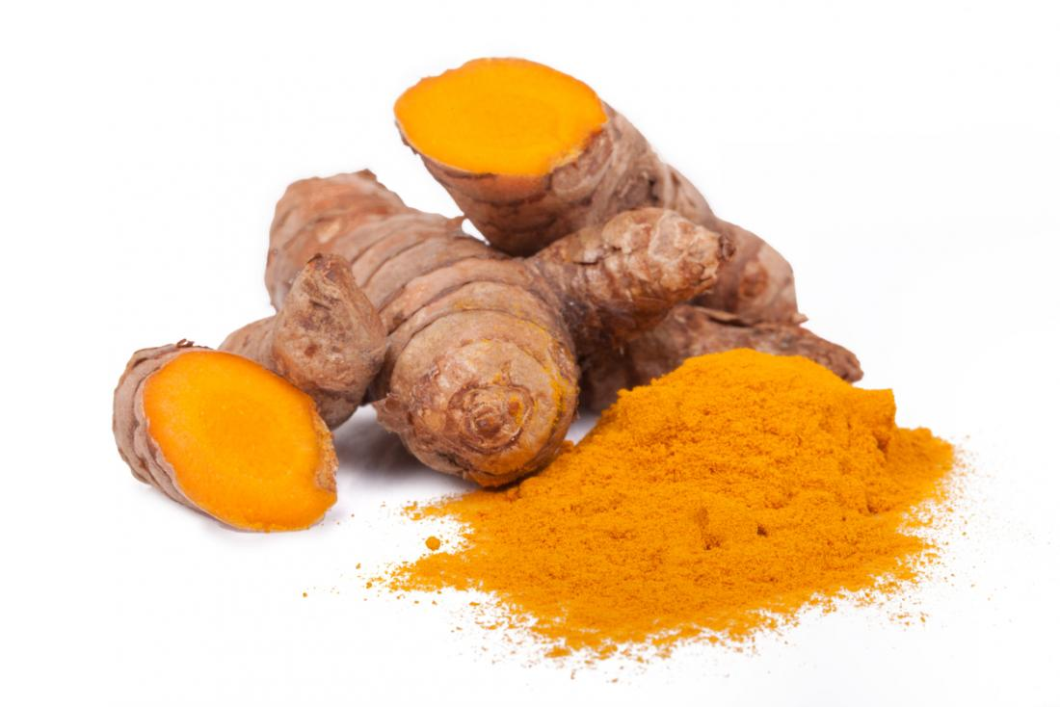

Slide 11

Olive oil from Greece

Slide 12
Culture and HIV
Where will you find more HIV cases, in a culture that supports monogamy or in a culture that support more fluid marital structures?
And how would this culture affect early detection of AIDS?

Slide 13
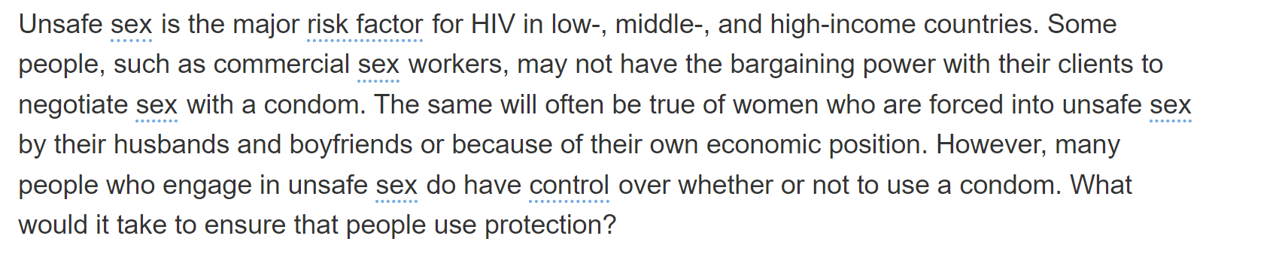
Notes:
Is there a link between culture and the use of condoms? Culture and the power of women? Culture and protection by the law?

Slide 14
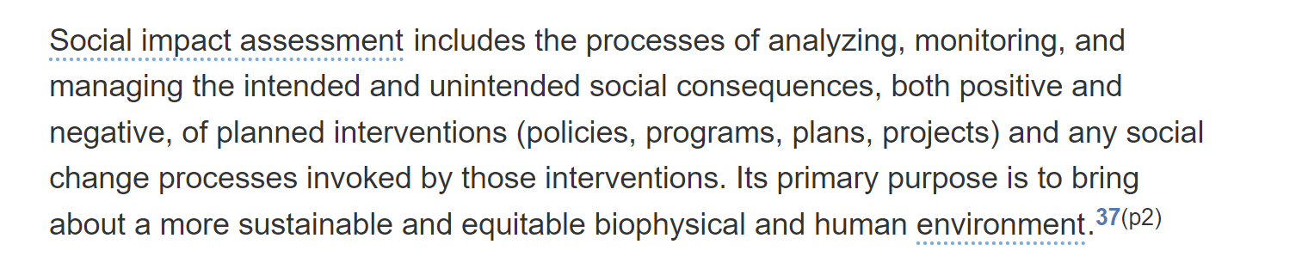
Social impact assessment
Notes:
P. 178 for your essays?

Slide 15
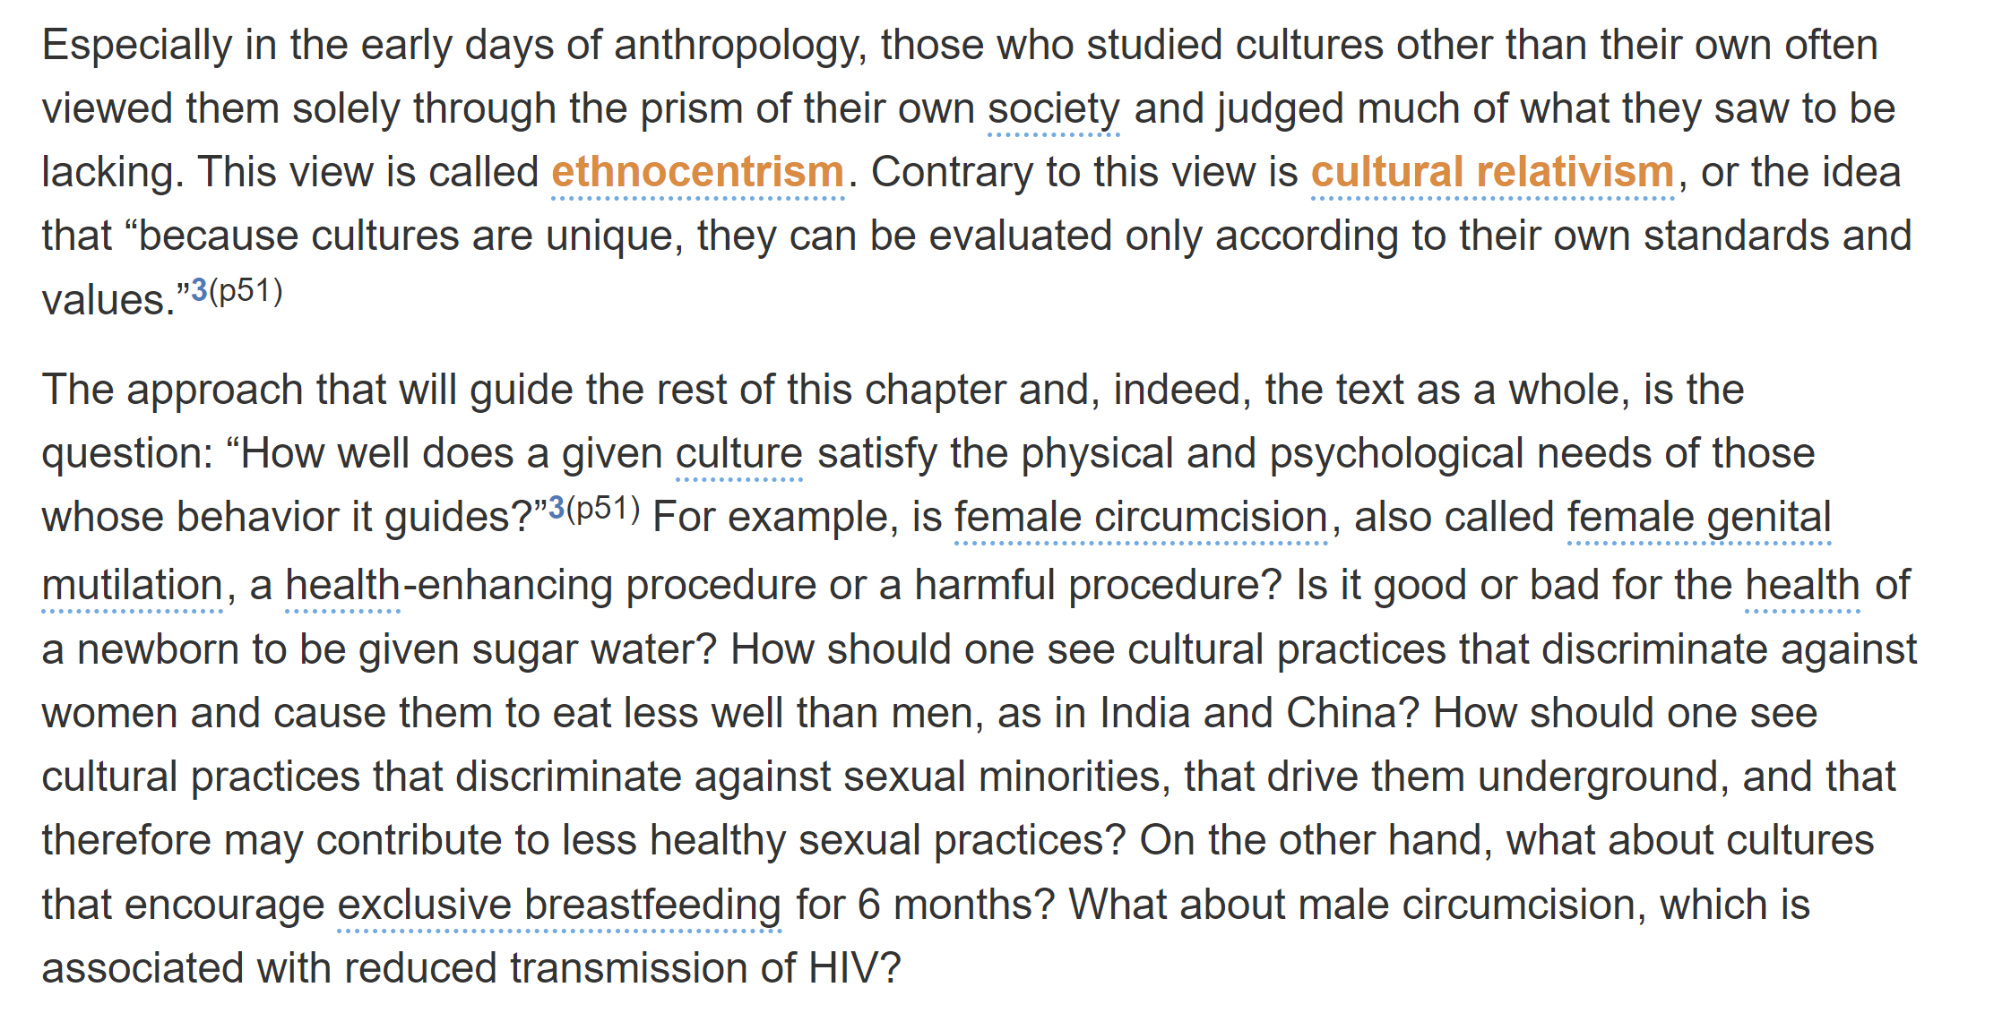
Notes:
P. 168 Is this text ethnocentrist?

Slide 16
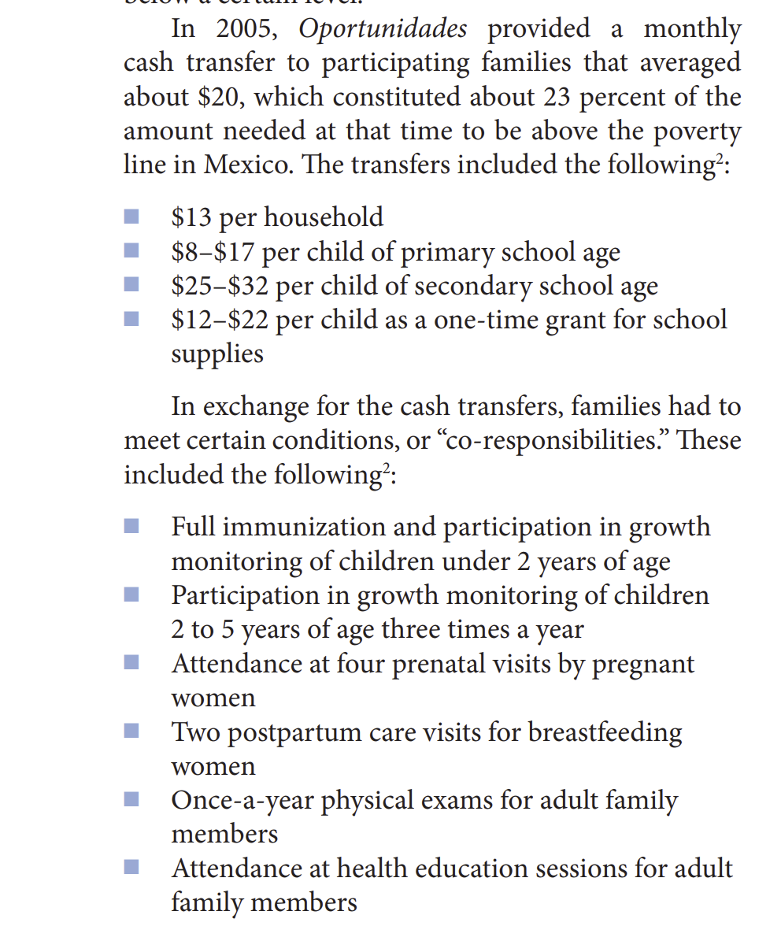
Conditional Cash Transfers (CCT) in Mexico (creating behavioural change)
What is likely to work in this intervention?
How can you be critical about it?

Slide 17
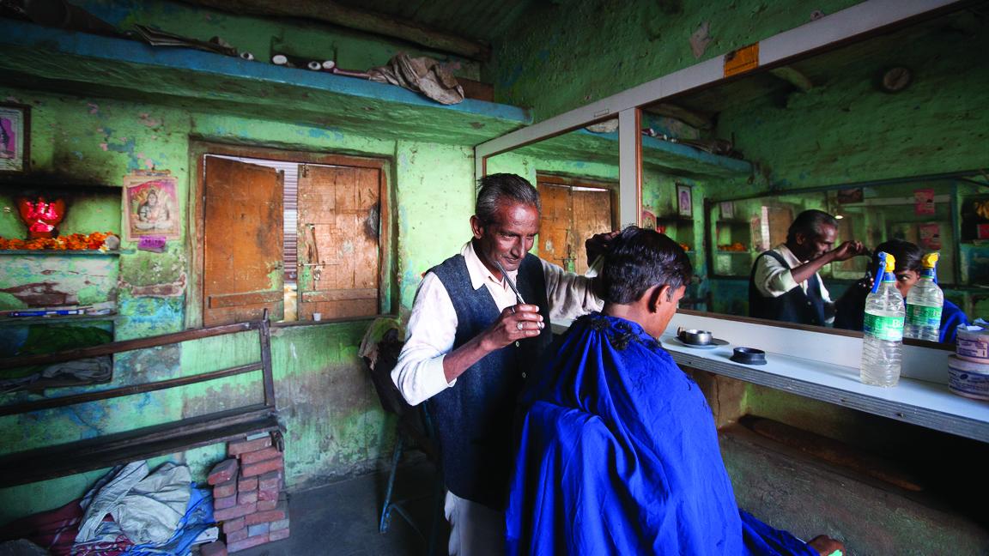
Understanding and Engendering Behavior Change
Barber shops in many countries are “community centers” in which men congregate for discussion. Several countries have created programs in which barbershops and barbers provide health education messages

Slide 18

See you next week
Or not…(crying emoji)
You have been absolutely smashingly delightful
I will miss you endlessly
Make yourself proud with your beautiful essays
Fill the module evaluation so I can learn from me and no one tells me off…

